Slide 1


UNIT 4
Requirement Analysis and Specification

Slide 2



Content
Understanding the Requirement
Requirement Modeling
Requirement Specification (SRS)
Requirement Analysis and Requirement Elicitation
Requirement Engineering
Unit 4

Slide 3
Understanding the Requirement
Requirement Engineering:
1. Inception—ask a set of questions that establish …
basic understanding of the problem
the people who want a solution
the nature of the solution that is desired, and
the effectiveness of preliminary communication and collaboration between the customer and the developer
2. Elicitation—elicit requirements from all stakeholders
3. Elaboration—create an analysis model that identifies data, function and behavioral requirements
4. Negotiation—agree on a deliverable system that is realistic for developers and customers
Unit 4

Slide 4
4. Specification—can be any one (or more) of the following:
A written document
A set of models
A formal mathematical
A collection of user scenarios (use-cases)
A prototype
5. Validation—a review mechanism that looks for
errors in content or interpretation
areas where clarification may be required
missing information
inconsistencies (a major problem when large products or systems are engineered)
conflicting or unrealistic (unachievable) requirements.
6. Requirements management
Unit 4

Slide 5
Inception
Identify stakeholders
“who else do you think I should talk to?”
Recognize multiple points of view
Work toward collaboration
The first questions
Who is behind the request for this work?
Who will use the solution?
What will be the economic benefit of a successful solution
Is there another source for the solution that you need?
Unit 4

Slide 6
Eliciting Requirements
meetings are conducted and attended by both software engineers and customers
rules for preparation and participation are established
an agenda is suggested
a "facilitator" (can be a customer, a developer, or an outsider) controls the meeting
a "definition mechanism" (can be work sheets, flip charts, or wall stickers or an electronic bulletin board, chat room or virtual forum) is used
the goal is
to identify the problem
propose elements of the solution
negotiate different approaches, and
specify a preliminary set of solution requirements
Unit 4

Slide 7
Elaboration - Building the Analysis Model
Elements of the analysis model
Scenario-based elements
Functional—processing narratives for software functions
Use-case—descriptions of the interaction between an “actor” and the system
Class-based elements
Implied by scenarios
Behavioral elements
State diagram
Flow-oriented elements
Data flow diagram
Unit 4

Slide 8
Use-Cases
A collection of user scenarios that describe the thread of usage of a system
Each scenario is described from the point-of-view of an “actor”—a person or device that interacts with the software in some way
Each scenario answers the following questions:
Who is the primary actor, the secondary actor (s)?
What are the actor’s goals?
What preconditions should exist before the story begins?
What main tasks or functions are performed by the actor?
What extensions might be considered as the story is described?
What variations in the actor’s interaction are possible?
What system information will the actor acquire, produce, or change?
Will the actor have to inform the system about changes in the external environment?
What information does the actor desire from the system?
Does the actor wish to be informed about unexpected changes?
Unit 4

Slide 9
Use-Case Diagram
Unit 4

Slide 10
Class Diagram
From the SafeHome system …
Unit 4

Slide 11
State Diagram
Reading
Commands
State name
System status = “ready”
Display msg = “enter cmd”
Display status = steady
State variables
Entry/subsystems ready
Do: poll user input panel
Do: read user input
Do: interpret user input
State activities
Unit 4

Slide 12
Negotiating Requirements
Identify the key stakeholders
These are the people who will be involved in the negotiation
Determine each of the stakeholders “win conditions”
Win conditions are not always obvious
Negotiate
Work toward a set of requirements that lead to “win-win”
Unit 4

Slide 13
Validating Requirements
Is each requirement consistent with the overall objective for the system/product?
Have all requirements been specified at the proper level of abstraction? That is, do some requirements provide a level of technical detail that is inappropriate at this stage?
Is the requirement really necessary or does it represent an add-on feature that may not be essential to the objective of the system?
Is each requirement bounded and unambiguous?
Does each requirement have attribution? That is, is a source (generally, a specific individual) noted for each requirement?
Do any requirements conflict with other requirements?
Unit 4

Slide 14
Contd…
Is each requirement achievable in the technical environment that will house the system or product?
Is each requirement testable, once implemented?
Does the requirements model properly reflect the information, function and behavior of the system to be built.
Has the requirements model been “partitioned” in a way that exposes progressively more detailed information about the system.
Have requirements patterns been used to simplify the requirements model. Have all patterns been properly validated? Are all patterns consistent with customer requirements?
Unit 4

Slide 15
Requirement Modeling
Requirement Analysis:
specifies software’s operational characteristics
indicates software's interface with other system elements
establishes constraints that software must meet
Requirements analysis allows the software engineer (called an analyst or modeler in this role) to:
elaborate on basic requirements established during earlier requirement engineering tasks
build models that depict user scenarios, functional activities, problem classes and their relationships, system and class behavior, and the flow of data as it is transformed.
Unit 4

Slide 16
A Bridge
Unit 4

Slide 17
Rules of Thumb
The model should focus on requirements that are visible within the problem or business domain. The level of abstraction should be relatively high.
Each element of the analysis model should add to an overall understanding of software requirements and provide insight into the information domain, function and behavior of the system.
Delay consideration of infrastructure and other non-functional models until design.
Minimize coupling throughout the system.
Be certain that the analysis model provides value to all stakeholders.
Keep the model as simple as it can be.
Unit 4

Slide 18
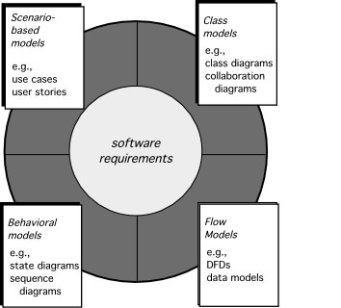
Elements of Requirements Analysis
Unit 4

Slide 19
Scenario-Based Modeling
“[Use-cases] are simply an aid to defining what exists outside the system (actors) and what should be performed by the system (use-cases).” Ivar Jacobson
(1) What should we write about?
(2) How much should we write about it?
(3) How detailed should we make our description?
(4) How should we organize the description?
Unit 4

Slide 20
What to Write About?
Inception and elicitation—provide you with the information you’ll need to begin writing use cases.
Requirements gathering meetings, QFD (Quality Function Deployment), and other requirements engineering mechanisms are used to
identify stakeholders
define the scope of the problem
specify overall operational goals
establish priorities
outline all known functional requirements, and
describe the things (objects) that will be manipulated by the system.
To begin developing a set of use cases, list the functions or activities performed by a specific actor.
Unit 4

Slide 21
How Much to Write About?
As further conversations with the stakeholders progress, the requirements gathering team develops use cases for each of the functions noted.
In general, use cases are written first in an informal narrative fashion.
If more formality is required, the same use case is rewritten using a structured format similar to the one proposed.
Unit 4

Slide 22
Use-Cases
a scenario that describes a “thread of usage” for a system
actors represent roles people or devices play as the system functions
users can play a number of different roles for a given scenario
Unit 4

Slide 23
Developing a Use-Case
What are the main tasks or functions that are performed by the actor?
What system information will the the actor acquire, produce or change?
Will the actor have to inform the system about changes in the external environment?
What information does the actor desire from the system?
Does the actor wish to be informed about unexpected changes?
Unit 4

Slide 24
Use-Case Diagram
Unit 4

Slide 25
Activity Diagram
Supplements the use case by providing a graphical representation of the flow of interaction within a specific scenario
Unit 4

Slide 26
Swimlane Diagrams
Allows the modeler to represent the flow of activities described by the use-case and at the same time indicate which actor (if there are multiple actors involved in a specific use-case) or analysis class has responsibility for the action described by an activity rectangle
Unit 4

Slide 27
Data Modeling
examines data objects independently of processing
focuses attention on the data domain
creates a model at the customer’s level of abstraction
indicates how data objects relate to one another
Unit 4

Slide 28
Data Objects and Attributes
A data object contains a set of attributes that act as an aspect, quality, characteristic, or descriptor of the object
object: automobile
attributes:
make
model
body type
price
options code
Unit 4

Slide 29
ERD Notation
One common form:
(0, m)
object
relationship
object
1
(1, 1)
2
attribute
Another common form:
object
relationship
object
1
2
(0, m)
(1, 1)
Unit 4

Slide 30
Building an ERD
Level 1—model all data objects (entities) and their “connections” to one another
Level 2—model all entities and relationships
Level 3—model all entities, relationships, and the attributes that provide further depth
Unit 4

Slide 31
The ERD: An Example
request
for service
Customer
places
(1,1)
(1,m)
(1,1)
standard
task table
(1,n)
work
order
generates
(1,1)
(1,1)
(1,1)
selected
from
work
tasks
(1,w)
(1,w)
consists
of
(1,i)
materials
lists
Unit 4

Slide 32
Class-Based Modeling
Class-based modeling represents:
objects that the system will manipulate
operations (also called methods or services) that will be applied to the objects to effect the manipulation
relationships (some hierarchical) between the objects
collaborations that occur between the classes that are defined.
The elements of a class-based model include classes and objects, attributes, operations, CRC models, collaboration diagrams and packages.
Unit 4

Slide 33
CRC Models
Class-responsibility-collaborator (CRC) modeling [Wir90] provides a simple means for identifying and organizing the classes that are relevant to system or product requirements. Ambler [Amb95] describes CRC modeling in the following way:
A CRC model is really a collection of standard index cards that represent classes. The cards are divided into three sections. Along the top of the card you write the name of the class. In the body of the card you list the class responsibilities on the left and the collaborators on the right.
Unit 4

Slide 34
CRC Modeling
Unit 4

Slide 35
Composite Aggregate Class
Unit 4

Slide 36
Associations and Dependencies
Two analysis classes are often related to one another in some fashion
In UML these relationships are called associations
Associations can be refined by indicating multiplicity (the term cardinality is used in data modeling
In many instances, a client-server relationship exists between two analysis classes.
In such cases, a client-class depends on the server-class in some way and a dependency relationship is established
Unit 4

Slide 37
Multiplicity
Unit 4

Slide 38
Dependencies
Unit 4

Slide 39
Requirement Specification (SRS)
It contains a complete information description, a detailed functional description, a representation of system behaviour, an indication of performance requirements and design constraints, appropriate validation criteria, and other information pertinent to requirements.
Software requirement specification (SRS) is a document that completely describes what the proposed software should do without describing how software will do it.
The basic goal of the requirement phase is to produce the SRS, Which describes the complete behaviour of the proposed software.
SRS is also helping the clients to understand their own needs.
Unit 4

Slide 40
Characteristics of an SRS
Software requirements specification should be accurate, complete, efficient, and of high quality, so that it does not affect the entire project plan. An SRS is said to be of high quality when the developer and user easily understand the prepared document. Other characteristics of SRS are discussed below.
Correct
SRS is correct when all user requirements are stated in the requirements document.
The stated requirements should be according to the desired system.
This implies that each requirement is examined to ensure that it (SRS) represents user requirements.
Note that there is no specified tool or procedure to assure the correctness of SRS. Correctness ensures that all specified requirements are performed correctly.
Unit 4

Slide 41
Contd...
Unambiguous
SRS is unambiguous when every stated requirement has only one interpretation.
This implies that each requirement is uniquely interpreted.
In case there is a term used with multiple meanings, the requirements document should specify the meanings in the SRS so that it is clear and easy to understand
Complete
SRS is complete when the requirements clearly define what the software is required to do.
This includes all the requirements related to performance, design and functionality.
Ranked for importance/stability
All requirements are not equally important, hence each requirement is identified to make differences among other requirements.
For this, it is essential to clearly identify each requirement. Stability implies the probability of changes in the requirement in future.
Unit 4

Slide 42
Modifiable
The requirements of the user can change, hence requirements document should be created in such a manner that those changes can be modified easily, consistently maintaining the structure and style of the SRS.
Traceable
SRS is traceable when the source of each requirement is clear and facilitates the reference of each requirement in future.
For this, forward tracing and backward tracing are used.
Forward tracing implies that each requirement should be traceable to design and code elements.
Backward tracing implies defining each requirement explicitly referencing its source.
Verifiable
SRS is verifiable when the specified requirements can be verified with a cost-effective process to check whether the final software meets those requirements.
The requirements are verified with the help of reviews. Note that unambiguity is essential for verifiability.
Unit 4

Slide 43
Consistent
SRS is consistent when the subsets of individual requirements defined do not conflict with each other.
For example, there can be a case when different requirements can use different terms to refer to the same object.
There can be logical or temporal conflicts between the specified requirements and some requirements whose logical or temporal characteristics are not satisfied.
For instance, a requirement states that an event 'a' is to occur before another event 'b'. But then another set of requirements states (directly or indirectly by transitivity) that event 'b' should occur before event 'a'.
Unit 4

Slide 44
Attributes of Bad SRS Documents
Over-Specification – occurs when the analyst tries to address the “how to” aspects in the SRS document
Forward References – do not refer to the aspects that are discussed much later in the SRS document. It reduces the readability of the specification.
Wishful Thinking - this concerns to the description of aspects that would be difficult to implement.
Noise – presence of material not directly relevant to the software development process. Example: in the register customer function, suppose the analyst writes that the customer registration department is managed by clerks who report for work between 8:00 AM and 5:00 PM, 7 days a week. This information can be called noise as it would hardly be of any use to the software developers
Unit 4

Slide 45
Functional and Non-Functional Requirements
Functional requirements
These describe the functionality of a system -- how a system should react to a particular set of inputs and what should be the corresponding output.
Given a problem statement, the functional requirements could be identified by focusing on the following points:
Identify the high level functional requirements simply from the conceptual understanding of the problem. For example, a Library Management System, apart from anything else, should be able to issue and return books.
Identify the cases where an end user gets some meaningful work done by using the system. For example, in a digital library a user might use the "Search Book" functionality to obtain information about the books of his interest.
If we consider the system as a black box, there would be some inputs to it, and some output in return. This black box defines the functionalities of the system. For example, to search for a book, user gives title of the book as input and get the book details and location as the output.
Any high level requirement identified could have different sub-requirements. For example, "Issue Book" module could behave differently for different class of users, or for a particular user who has issued the book thrice consecutively.

Slide 46
Non-Functional requirements (NFR)
They are not directly related what functionalities are expected from the system.
However, NFRs could typically define how the system should behave under certain situations.
For example, a NFR could say that the system should work with 128MBRAM.
Unit 4

Slide 47
Example
List out the functional and non-functional requirements of Hotel Management System & draw the use case, activity diagram, class diagram, ER Diagram and DFD for the same
List out the functional and non-functional requirements of personal Library Management System & draw the use case, activity diagram, class diagram, ER Diagram and DFD for the same
Unit 4

Slide 48
Requirements Process
Aspect-Oriented Requirements
Object-Oriented Analysis & Design
Requirements gathering
Requirements analysis
Requirements specification
Structured Analysis & Design
Agile Development User Stories
Unit 4

Slide 49
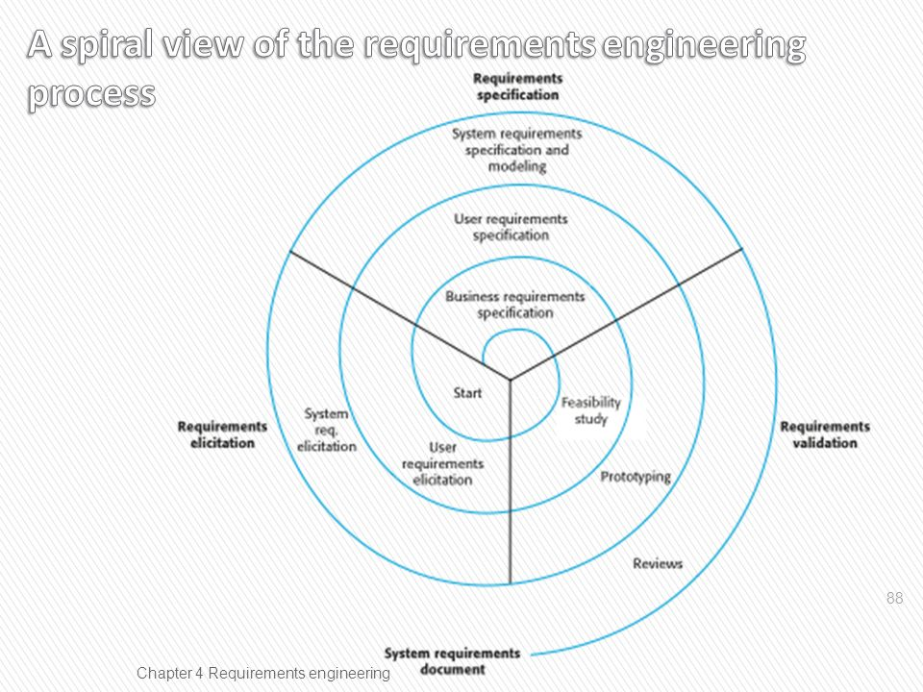

Slide 50
Requirements Engineering Components
Requirements gathering
(a.k.a. “requirements elicitation”) helps the customer to define what is required: what is to be accomplished, how the system will fit into the needs of the business, and how the system will be used on a day-to-day basis
Requirements analysis
refining and modifying the gathered requirements
Requirements specification
documenting the system requirements in a semiformal or formal manner to ensure clarity, consistency, and completeness
Unit 4

Slide 51
Requirements and Specification
Problem domain
Software (Solution) domain
Describes
Requirements
Specifi cation
Program
Customer
Specifies
Analyzes
Develops
Software Engineer
Unit 4

Slide 52
Example System Requirements
Identifier | Priority | Requirement
REQ1 | 5 | The system shall keep the door locked at all times, unless commanded otherwise by authorized user. When the lock is disarmed, a countdown shall be initiated at the end of which the lock shall be automatically armed (if still disarmed).
REQ2 | 2 | The system shall lock the door when commanded by pressing a dedicated button.
REQ3 | 5 | The system shall, given a valid key code, unlock the door and activate other devices.
REQ4 | 4 | The system should allow mistakes while entering the key code. However, to resist “dictionary attacks,” the number of allowed failed attempts shall be small, say three, after which the system will block and the alarm bell shall be sounded.
REQ5 | 2 | The system shall maintain a history log of all attempted accesses for later review.
REQ6 | 2 | The system should allow adding new authorized persons at runtime or removing existing ones.
REQ7 | 2 | The system shall allow configuring the preferences for device activation when the user provides a valid key code, as well as when a burglary attempt is detected.
REQ8 | 1 | The system should allow searching the history log by specifying one or more of these parameters: the time frame, the actor role, the door location, or the event type (unlock, lock, power failure, etc.). This function shall be available over the Web by pointing a browser to a specified URL.
REQ9 | 1 | The system should allow filing inquiries about “suspicious” accesses. This function shall be available over the Web.
Problem: Requirements prioritization.
See how solved in agile methods.

Slide 53
Acceptance Tests
An acceptance test specifies a set of scenarios for determining whether the finished system meets the customer requirements
An acceptance test case specifies, for a given “situation” or “context” (defined by current system inputs), the output or behavior the system will produce in response
Unit 4

Slide 54
Problem: Requirements Prioritization
When prioritizing requirements, “important” and “urgent” aspects can be confused
Also, it is difficult to assign a numeric value of priority to each requirement
It requires more mental effort than just rank-ordering the requirements in a linear sequence
Unit 4

Slide 55
User Stories
As a tenant, I can unlock the doors to enter my apartment.
user-role
(benefactor)
capability
business-value
Similar to system requirements, but focus on the user benefits, instead on system features.
Preferred tool in agile methods.
Unit 4

Slide 56
Example User Stories
Identifier | User Story | Size
ST-1 | As an authorized person (tenant or landlord), I can keep the doors locked at all times. | 4 points
ST-2 | As an authorized person (tenant or landlord), I can lock the doors on demand. | 3 pts
ST-3 | The lock should be automatically locked after a defined period of time. | 6 pts
ST-4 | As an authorized person (tenant or landlord), I can unlock the doors. (Test: Allow a small number of mistakes, say three.) | 9 points
ST-5 | As a landlord, I can at runtime manage authorized persons. | 10 pts
ST-6 | As an authorized person (tenant or landlord), I can view past accesses. | 6 pts
ST-7 | As a tenant, I can configure the preferences for activation of various devices. | 6 pts
ST-8 | As a tenant, I can file complaint about “suspicious” accesses. | 6 pts
Note no priorities for user stories.
Story priority is given by its order of appearance on the work backlog (described next)
Size points (last column) will be described later

Slide 57
Requirements Analysis Activities
Not only refinement of customer requirements, but also feasibility and how realistic
Needs to identify the points where business policies need to be applied.
Explicit identification of business policies (BP) is important for two reasons:
Making the need for BP explicit allows involving other stakeholders in decision about the solutions to adopt—Helps to involve others, particularly the customer, in decision making about each policy to adopt
Helps to anticipate potential future changes in the policies, so mechanisms can be implemented in the code that localize the future changes and allow quick substitution of business policies
Unit 4

Slide 58
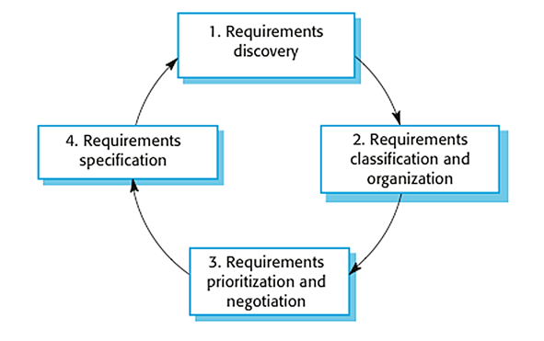
Requirements Elicitation
Unit 4

Slide 59
Requirements Elicitation Techniques
Interviewing
Open interviews – there are no predefned agendas
Closed interviews – stakeholders answers a predfined set of questions
Ethnography – watch people doing their job to see what artifacts they use, how they use them and so on.
Stories and scenarios
Unit 4

Slide 60
Types of Requirements
Functional Requirements
Non-functional requirements (or quality requirements)
FURPS+
Functionality (security), Usability, Reliability, Performance , Supportability
On-screen appearance requirements
Unit 4

Slide 61
On-screen Appearance Requirements
Do not waste your time and your customer’s time by creating elaborate screen shots with many embellishments, coloring, shading, etc., that serves only to distract attention from most important aspects of the interface
Hand-drawing the proposed interface forces you to economize and focus on the most important features
Only when there is a consensus that a good design is reached, invest effort to prototype the interface
Unit 4

Slide 62
Tools for Requirements Eng.
Tools, such as user stories and use cases, used for:
Determining what exactly the user needs (“requirements analysis”)
Writing a description of what system will do (“requirements specification”)
Difficult to use the same tool for different tasks (analysis vs. specification)
Unit 4

Slide 63
Acceptance Tests
Means of assessing that the requirements are met as expected
Conducted by the customer
An acceptance test describes whether the system will pass or fail the test, given specific input values
Cannot ever guarantee 100% coverage of all usage scenarios, but systematic approach can increase the degree of coverage
Unit 4

Slide 64
Project Estimation using User Story Points
Size points assigned to each user story
Total work size estimate:
Total size = Σ (points-for-story i), i = 1..N
Velocity (= productivity) estimated from experience
Estimate the work duration
Project duration =
Path size
Travel velocity
Unit 4

Slide 65
Example User Stories
Identifier | User Story | Size
ST-1 | As an authorized person (tenant or landlord), I can keep the doors locked at all times. | 4 points
ST-2 | As an authorized person (tenant or landlord), I can lock the doors on demand. | 3 pts
ST-3 | The lock should be automatically locked after a defined period of time. | 6 pts
ST-4 | As an authorized person (tenant or landlord), I can unlock the doors. (Test: Allow a small number of mistakes, say three.) | 9 points
ST-5 | As a landlord, I can at runtime manage authorized persons. | 10 pts
ST-6 | As an authorized person (tenant or landlord), I can view past accesses. | 6 pts
ST-7 | As a tenant, I can configure the preferences for activation of various devices. | 6 pts
ST-8 | As a tenant, I can file complaint about “suspicious” accesses. | 6 pts
Unit 4

Slide 66
Agile Estimation of Project Effort
1) Prune Section 6 1 day (2pts)
2 points per day
1 = 4 pts (2 days)
2 = 7 pts (3.5 days)
3 = 10 pts (5 days)
4 = 3 pts (1.5 days)
5 = 4 pts (2 days)
6 = 2 pts (1 day)
7 = 4 pts (2 days)
8 = 7 pts (3.5 days)
2) Prune Section 5 2 days (4pts)
3) Prune Section 7 2 days (4pts)
4) Prune Section 4 1.5 days (3p)
5) Prune Section 8 3.5 days (7p)
Work backlog
Estimated work duration
1) ST-4: Unlock 15 days (9pts)
2) ST-2: Lock 5 days (3pts)
Items pulled by the team into an iteration
3) ST-5: Manage Users 16 days (10pts)
4) ST-7: Preferences 10 days (6pts)
5) ST-6: View History 10 days (6pts)
6) ST-…
Work items
21 days
1st iteration
2nd iteration
n-th iteration
List prioritized by the customer
5 days
Estimated completion date
Time
Unit 4

Slide 67
Agile Estimation of Project Effort
Work backlog
Estimated work duration
1) ST-4: Unlock 11 days (6pts)
2) ST-2: Lock 4 days (2pts)
Items pulled by developers into an iteration
3) ST-5: Manage Users 14 days (8pts)
4) ST-7: Set Preferences 10 days (6pts)
5) ST-6: View History 7 days (4pts)
6) ST-_:
Work items
117 days
1st iteration
2nd iteration
n-th iteration
List prioritized by the customer
30 days
Estimated completion date
Time
Unit 4

Slide 68
Agile Prioritization of Work
Instead of assigning priorities, the customer creates an ordered list of user stories
Developers simply remove the top list items and work on them in the next iteration
Work backlog
1) ST-4: Unlock 11 days (6pts)
2) ST-2: Lock 4 days (2pts)
Items pulled by developers into an iteration
3) ST-5: Manage Users 14 days (8pts)
4) ST-7: Set Preferences 10 days (6pts)
5) ST-6: View History 7 days (4pts)
6) ST-_:
117 days
1st iteration
List prioritized by the customer
30 days
Estimated completion date
Time
Unit 4

Slide 69
Tradeoff between Customer Flexibility and Developer Stability
Items pulled by developers into an iteration are not subject to further customer prioritization
Developers have a steady goal until the end of the current iteration
Customer has flexibility to change priorities in response to changing market forces
Step 1:
Remove from the backlog user stories scheduled for the next iteration
Work backlog
• ST-4: Unlock 11 days (6pts)
1) ST-5: Manage Users 14 days (8pts)
• ST-2: Lock 4 days (2pts)
2) ST-7: Set Preferences 10 days (6pts)
3) ST-6: View History 7 days (4pts)
4) ST-_:
Step 2:
Shift remaining user stories to the top of the backlog and allow customer re-prioritization
117 days
1st iteration
Work iteration currently in progress
30 days
Estimated completion date
Time
Unit 4

Slide 70
How To Combine the Part Sizes?
Costs are not always additive
But, solution (c) is not necessarily “cheaper” than (b) …
Unit 4

Slide 71
Additional Costs
Highway traffic-circle interchange
Traffic signs
Unit 4

Slide 72
Requirement Specification
Natural language Specification
Structured Specifications
Use Cases
Software Requirements Document
Unit 4

Slide 73
Requirements Validation
Validation Checks – checks that the requirements reflect the real needs of the system users.
Consistency Checks – requirements in the document should not conflict.
Completeness Checks – requirements document should include the requirements that define all the functions and constraints intended by the system user.
Realism Checks – whether the requirements can be implemented within the proposed budget for the system.
Verifiability – to reduce the potential for dispute between the customer and the contractor, the system requirements should always be written so that they are verifiable.
Unit 4

Slide 74
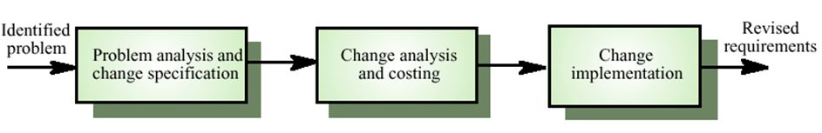
Requirements Change Management
Unit 4

Slide 75


